Slide 1
Development of master curricula for natural disasters risk management in Western Balkan countries
NATRISK PROJECT – KPA PROGRESS REPORT
Saša Mijalković, PhD
Academy for Criminalistic and Police Studies, Belgrade, Serbia
Chania, Crete, Greece / 4-7 September 2018
Project number: 573806-EPP-1-2016-1-RS-EPPKA2-CBHE-JP
"This project has been funded with support from the European Commission. This publication reflects the views only of the author, and the Commission cannot be held responsible for any use which may be made of the information contained therein"

Slide 2
DEVELOPMENT OF MASTER CURRICULA
Development of master curricula for natural disasters risk management in Western Balkan countries
Master studies: Natural Disasters Security Risk Management;
Courses content and syllabi were created; updating and entry into the accreditation software was made, with the approval of the Ministry of the Interior of the Republic of Serbia;
The Senate adopted the master study program;
Documentation for the accreditation of master program was sent to the Comission for Accreditation and Quality Assurance;
Master program official leaflet and brochure are finalized.

Slide 3
INTER-INSTITUTIONAL AGREEMENTS
Development of master curricula for natural disasters risk management in Western Balkan countries
Inter-institutional agreements were signed with:
Technical University of Crete, Chania
Middlesex University, London
Obuda University, Budapest
Faculty of Security Science, University of Banja Luka
Technical College of Applied Sciences, Leposavić

Slide 4
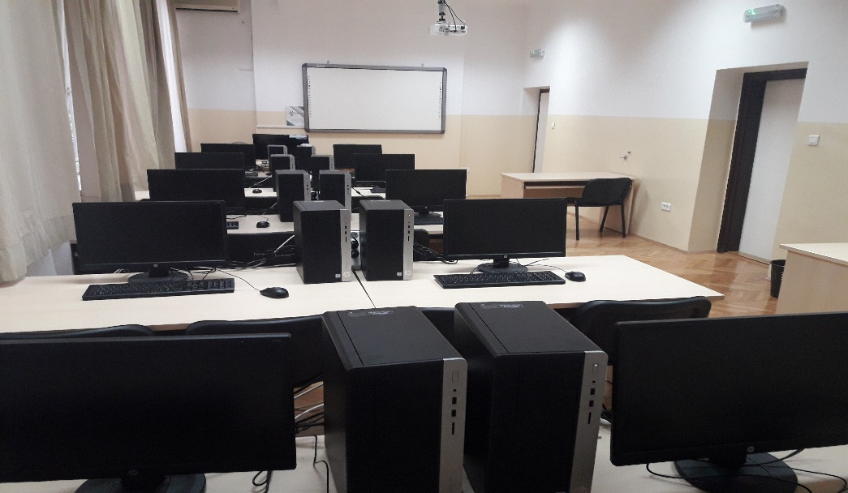
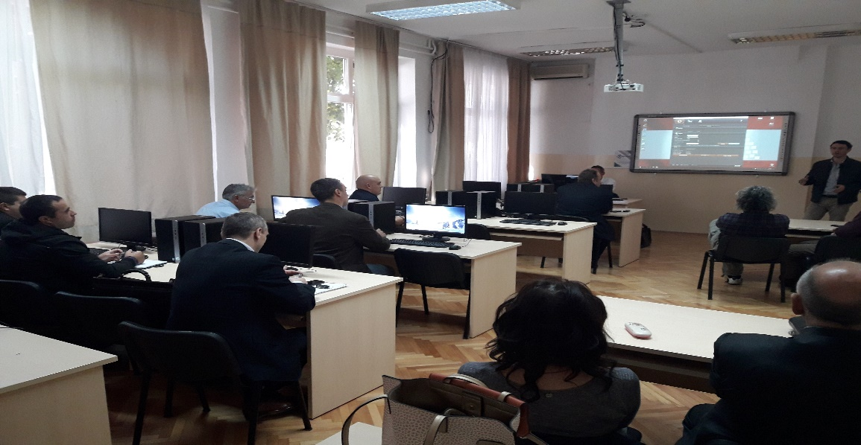
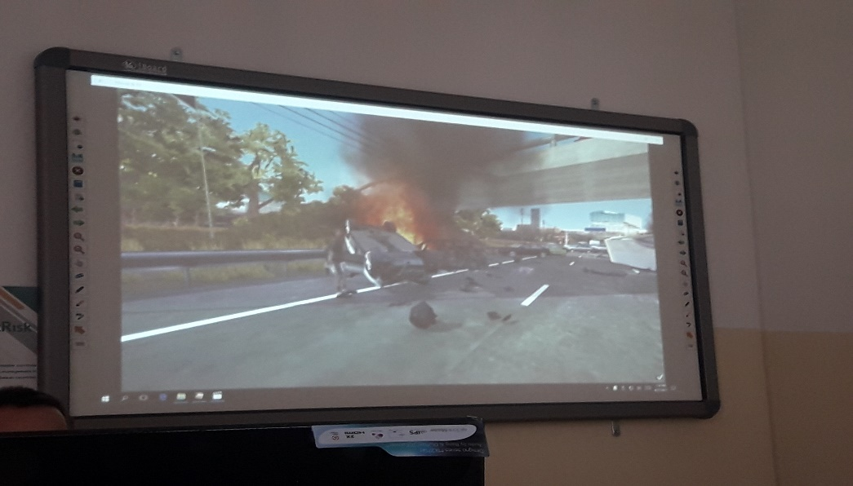
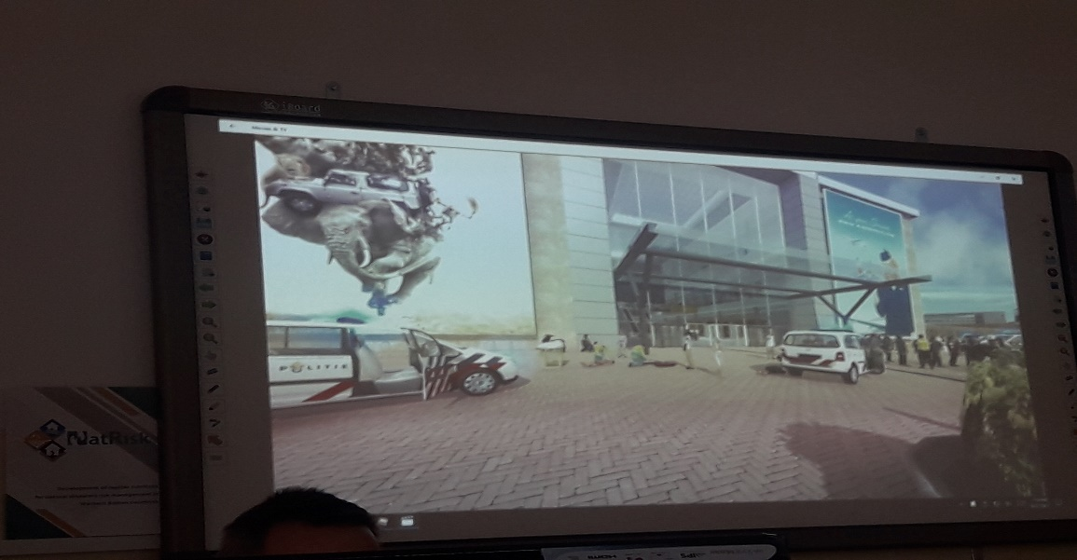
EQUIPMENT
Development of master curricula for natural disasters risk management in Western Balkan countries
Equipment and specialized classroom are marked with official NatRisk stickers.

Slide 5
DISSEMINATION
Development of master curricula for natural disasters risk management in Western Balkan countries
Dissemination of the NatRisk project was made on following occasions:
The VII International Scientific Conference “Archibald Reiss Days”, held on 7-9 November 2017 on the Academy of Criminalistic and Police Studies;
During the visit of the People's Public Security University of China delegation to the Academy, held on 24 November 2017;
Workshop with similar Erasmus+ projects of the ImprESS project, held on 15 December 2017 on the Academy;
A short film was shot at the Academy on January 16 by the Tempus Office in Belgrade, and the role of the Academy in the NatRisk project and the purchased equipment were presented;
A meeting with the Tempus foundation - Erasmus office in Belgrade was held at the Academy on 5 March 2018;
A meeting with the ImprESS Erasmus+ project financial team members was held on the Academy on 21 March 2018, when experiences related to material-financial management on the NatRisk project were presentated...

Slide 6
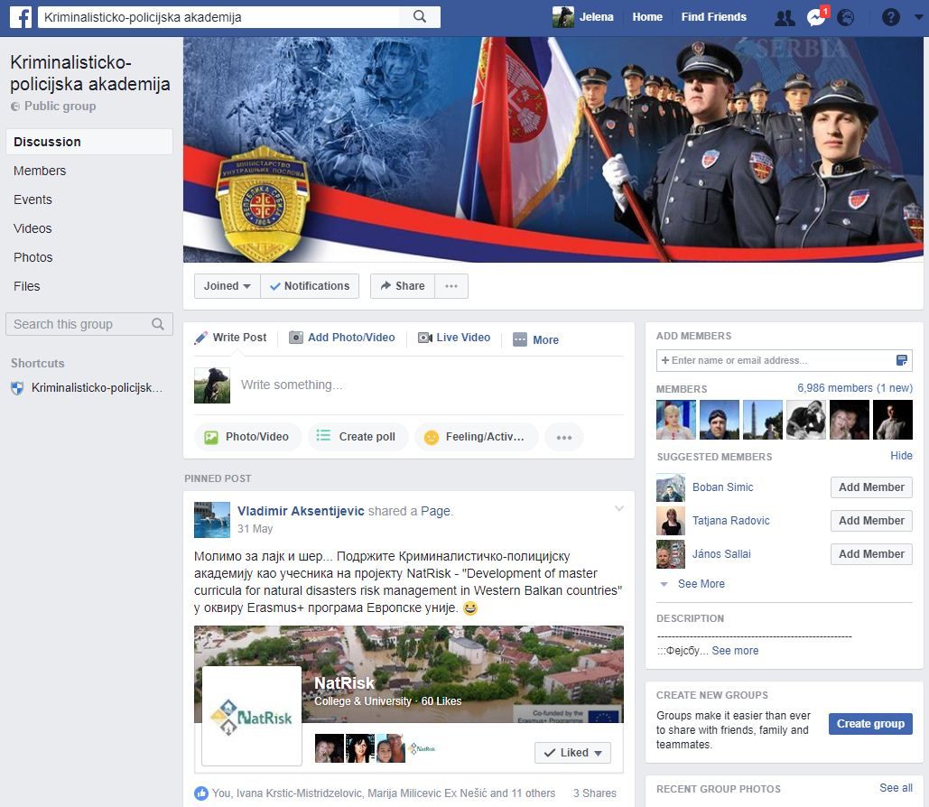
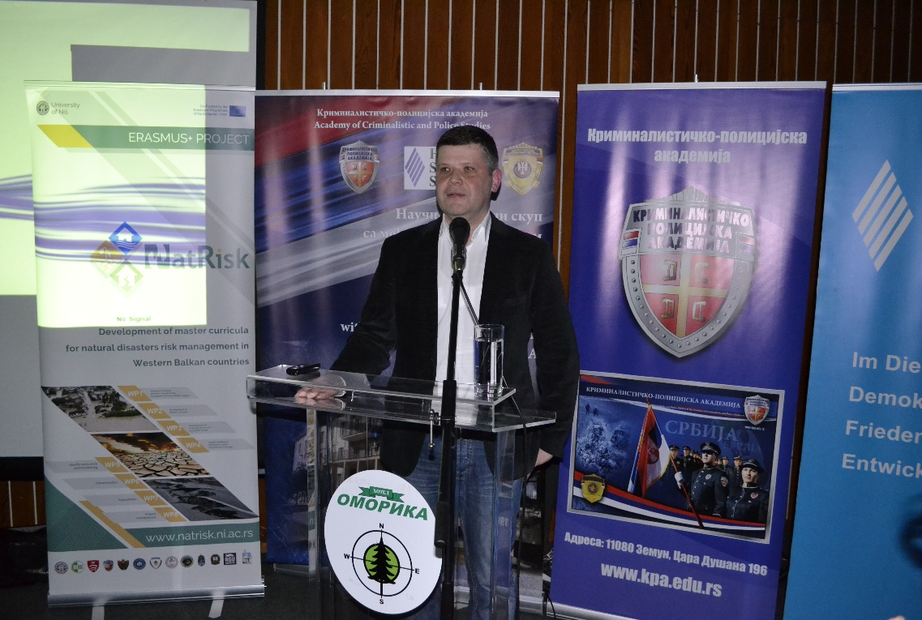
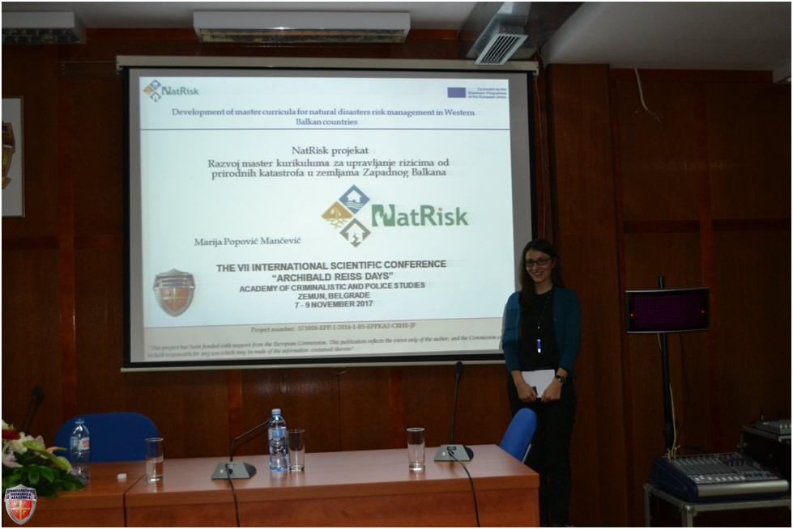
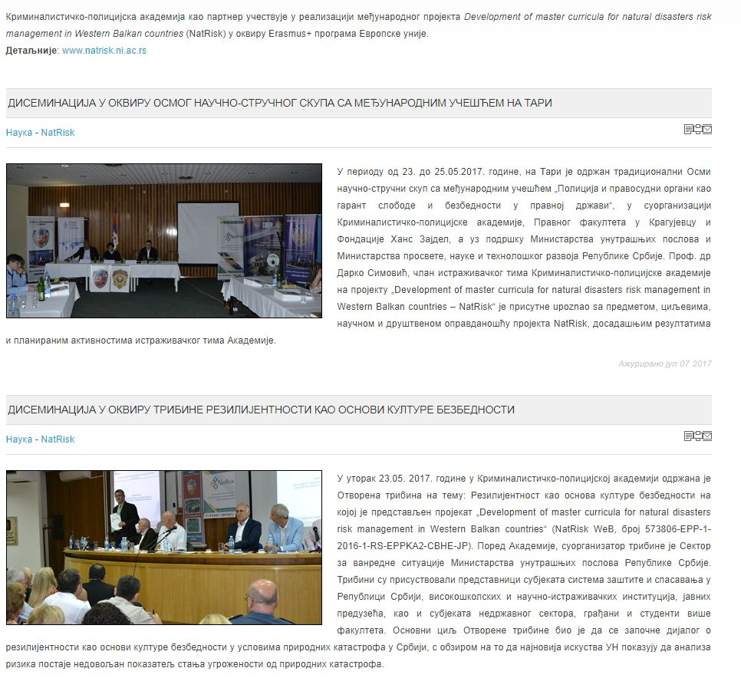
Development of master curricula for natural disasters risk management in Western Balkan countries

Slide 7
DISSEMINATION
Development of master curricula for natural disasters risk management in Western Balkan countries
The Regional Conference „Regional Cooperation in Combating Transborder Crime: Contemporary Challenges of Terrorism and the Migrant Crisis“, held in Ethno-village Stanišići, Bijeljina, Republic of Srpska, B&H, from 22-24 May 2018;
The Thematic meeting „Models of professional practice as a mean of increasing the employability of students in Serbia“, held in Belgrade on 4 July 2018, with the representatives from the Ministry of Education, Science and Technological Development, Tempus Fondation – Eramsus+ Office in Belgrade and various Erasmus+ project members;
KPA project team member attended a meeting in Belgrade on 5 July 2018, with Mr. Branko Dragičević, Deputy Director of the Seismological Survey of Serbia, when the Agreement on business and technical cooperation between the Academy of Criminalistic and Police Studies and the Seismological Survey of Serbia was officially signed;
A meeting with the Tempus Office in Belgrade and NatRisk and ImprESS project team members was held on the Academy on 6 July 2018.

Slide 8
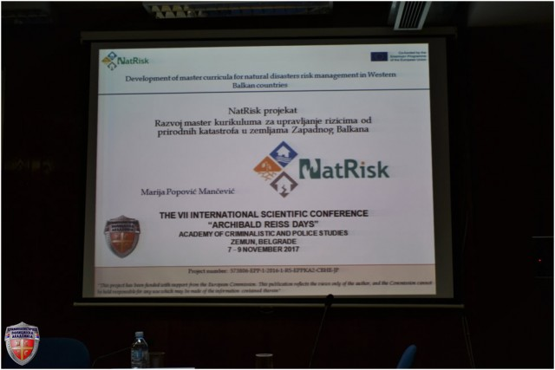
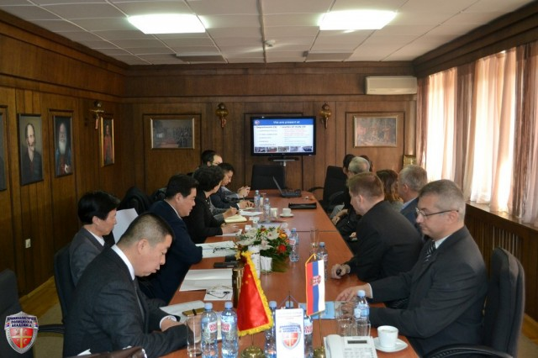
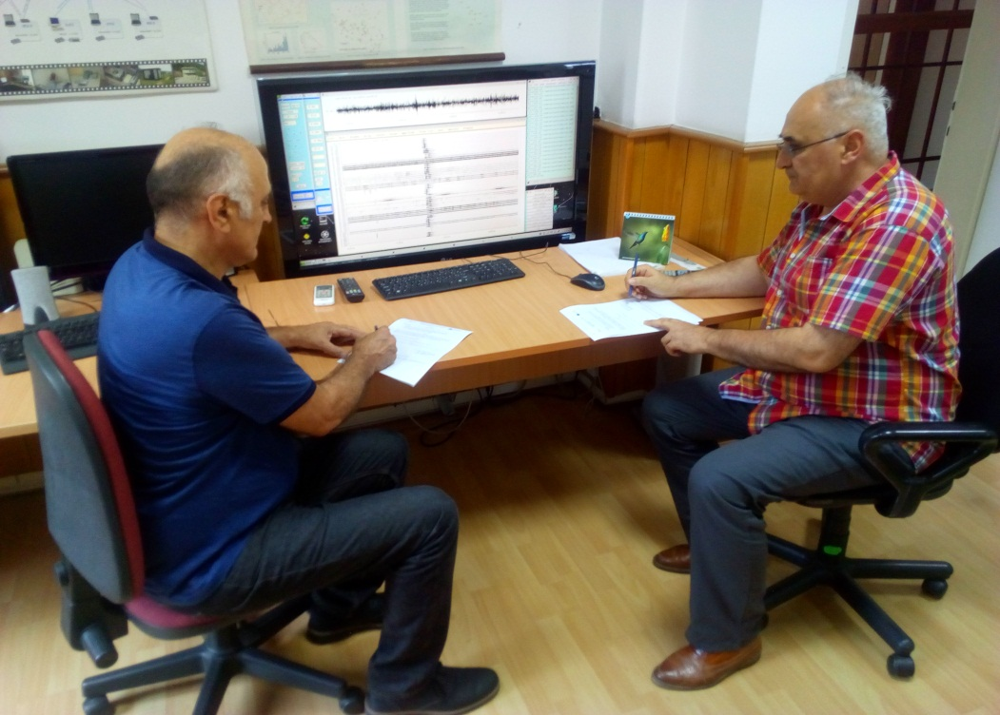
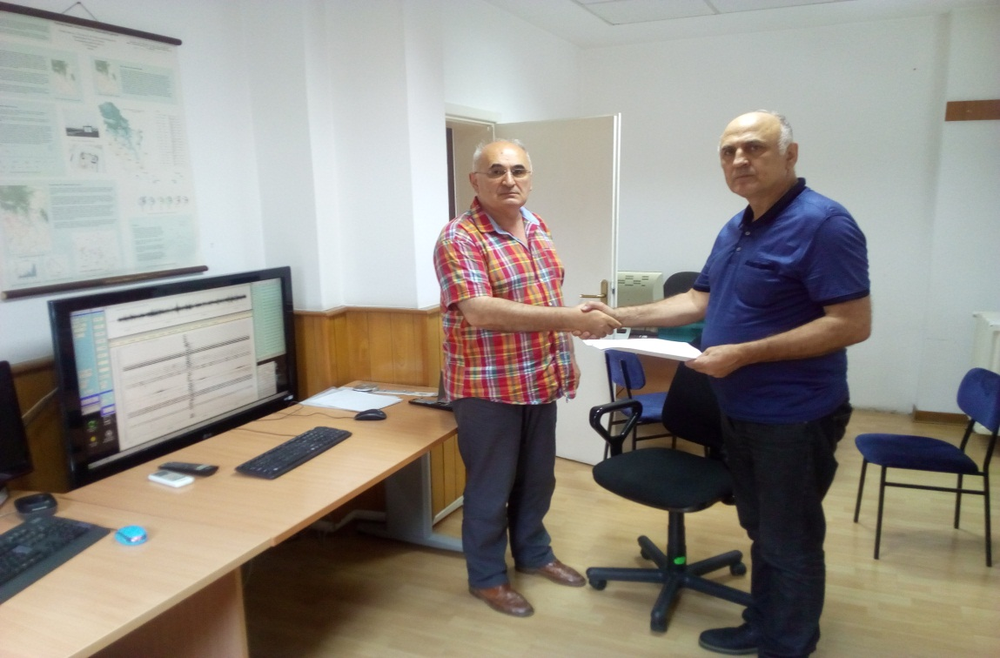
Development of master curricula for natural disasters risk management in Western Balkan countries

Slide 9
TRAINING FOR CITIZENS AND PUBLIC SECTOR
Development of master curricula for natural disasters risk management in Western Balkan countries
The Handbook for Civil Sector Training for Risk Management in Emergencies was completed;
Plan for Civil Sector Training for Risk Management in Emergencies was developed;
Training for Citizens and Public Sector for Risk Management in Emergencies was held at the Academy on 17-18 May 2018.

Slide 10
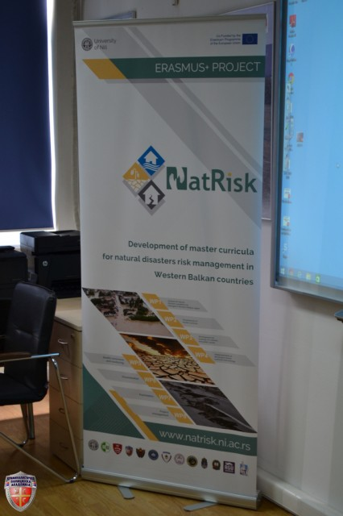
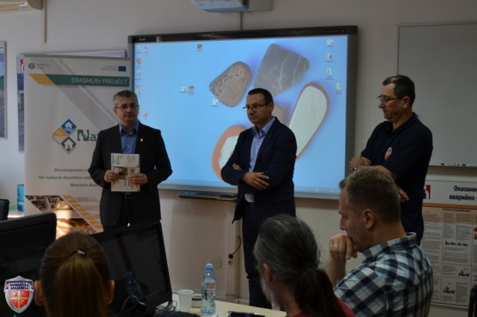
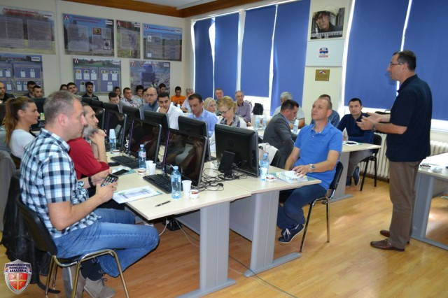
Development of master curricula for natural disasters risk management in Western Balkan countries

Slide 11
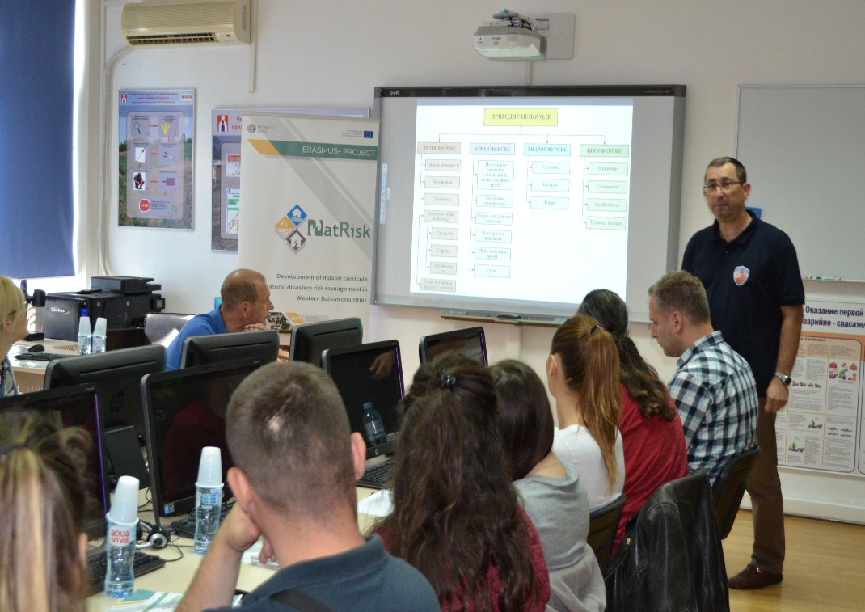
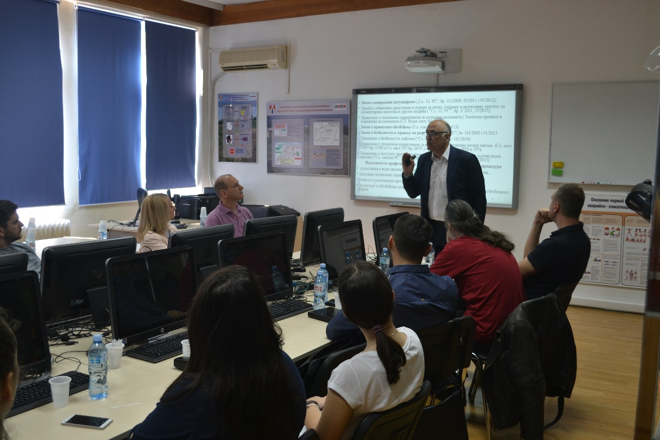
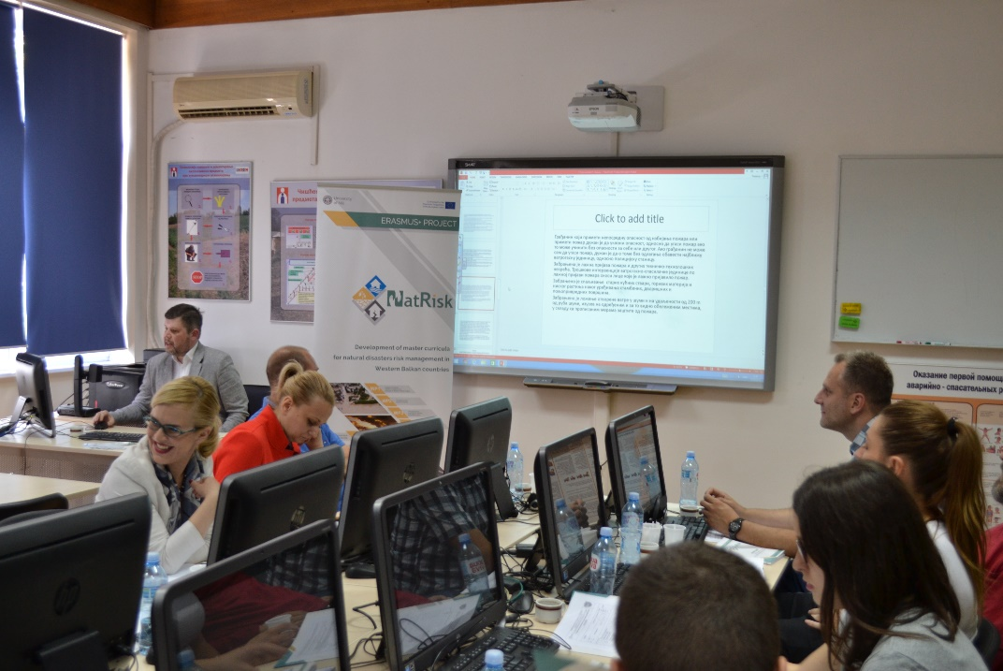
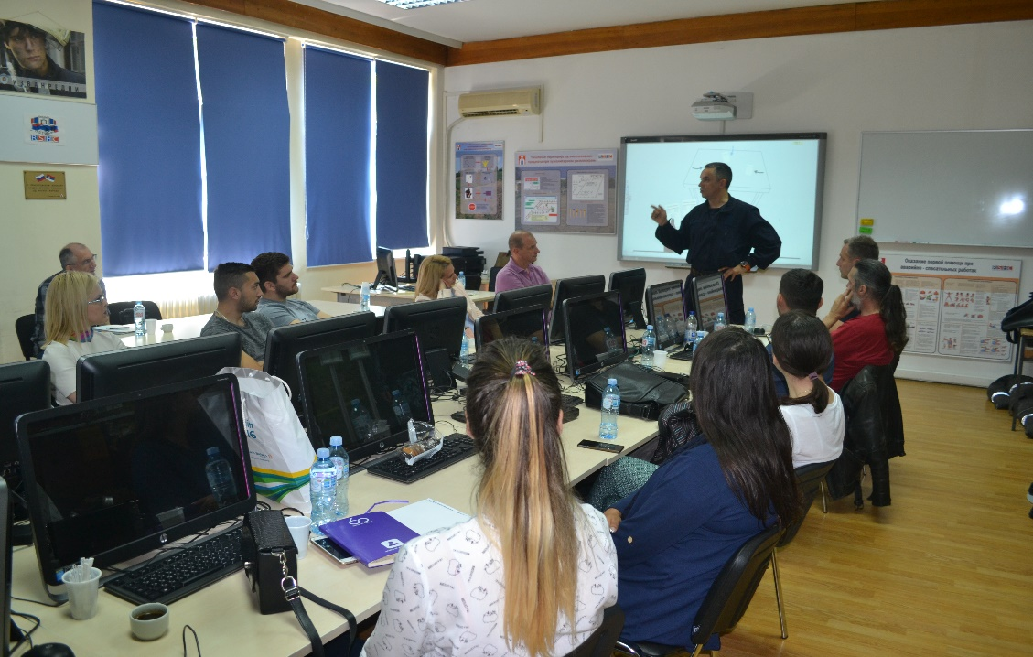
Development of master curricula for natural disasters risk management in Western Balkan countries

Slide 12
SPECIAL MOBILITY STRAND
Development of master curricula for natural disasters risk management in Western Balkan countries
Rulebook on mobility of teaching and non-teaching staff and students, along with the accompanying forms, was adopted
Staff selection for Special Mobility Strand staff mobility to Technical University of Crete, Chania, Crete, Greece, has been successfully completed
Staff selection for Special Mobility Strand staff mobility to Middlesex University, London, UK, has been successfully completed
Staff selection for Special Mobility Strand staff mobility to Obuda University, Budapest, Hungary, has been successfully completed
Students from Faculty of Security Science, University of Banja Luka and Technical College of Applied Sciences, Leposavić, are coming to the Academy for mobility activities

Slide 13
Development of master curricula for natural disasters risk management in Western Balkan countries
THANK YOU FOR YOUR ATTENTION!

